Slide 1

Community Service Project — Program Book
By Pithani Bhargavi Sri Satya Srujana — Reg: 23VV1A0547Department of Computer Science & Engineering, JNTUGV‑CEV

Slide 2

Project Overview
Community Service Project (CSP) — Web Development for Vinutna Junior College, Kakinada. Period: 10‑05‑2025 to 12‑06‑2025. Mentor: Mr. V. Laxmi Prasad.
Purpose
Combine community service with academic learning to improve the college's digital presence and student accessibility.

Slide 3

Objectives
Identify Needs
Map digital gaps for local institutions, schools and NGOs lacking an online presence.
Apply Skills
Use HTML, CSS, JavaScript and Express.js to build functional, responsive sites.
Promote Inclusion
Enable communities to share information, services and announcements online.
Empower
Train staff to maintain sites and improve long‑term digital accessibility.

Slide 4
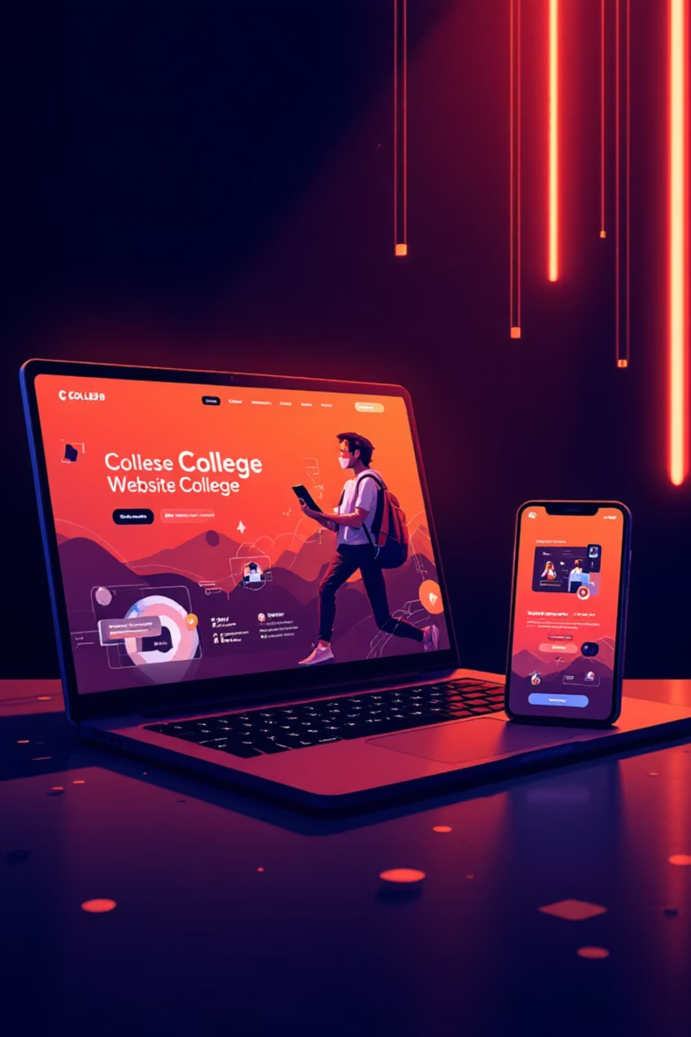
Why Vinutna Junior College?
Opportunity
Impact
Outcomes
College needed a professional online presence to showcase courses, coaching and admissions.
Improved accessibility for students, parents and faculty; centralised information hub.
Modernised communication, streamlined admissions, and enhanced community reach.

Slide 5
Project Timeline — 5 Weeks (180 hrs)
Survey
1
10–14 May — Need analysis, content collection, stakeholder interviews.
2
Design
15–19 May — Wireframes, Figma prototypes, tech stack finalised.
Frontend
3
20–25 May — HTML/CSS/JS development, iterative feedback.
4
Backend
26 May–4 June — Express.js server, form handling, Nodemailer integration.
Testing & Deploy
5
5–12 June — Manual testing, Vercel frontend, Render backend, final demo.

Slide 6


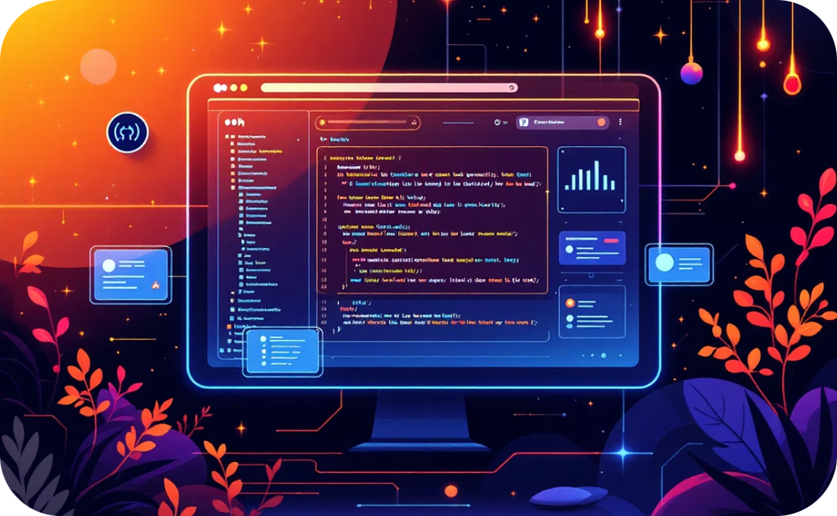
Technical Implementation
Frontend
Backend
Deployment
Responsive pages using HTML, CSS, JavaScript and Bootstrap for consistent UI.
Express.js server to process form submissions and integrate Nodemailer for emails.
Frontend on Vercel, backend on Render; GitHub for version control and collaboration.

Slide 7

Testing & Quality
Manual testing across devices and browsers with focus on functionality, compatibility, performance and accessibility.
Functionality
Forms, links, navigation and dynamic content verified.
Compatibility
Checked on Chrome, Edge, Firefox and varied screen sizes.
Accessibility
Ensured ease of use for non‑technical users and responsive layout.

Slide 8

Skills Gained
Life Skills
Technical Skills
Communication
HTML, CSS, JavaScript, Bootstrap
Organisation
Critical thinking
Express.js, Nodemailer
Patience & active listening
GitHub, deployment (Vercel, Render)
UI/UX planning, wireframing

Slide 9


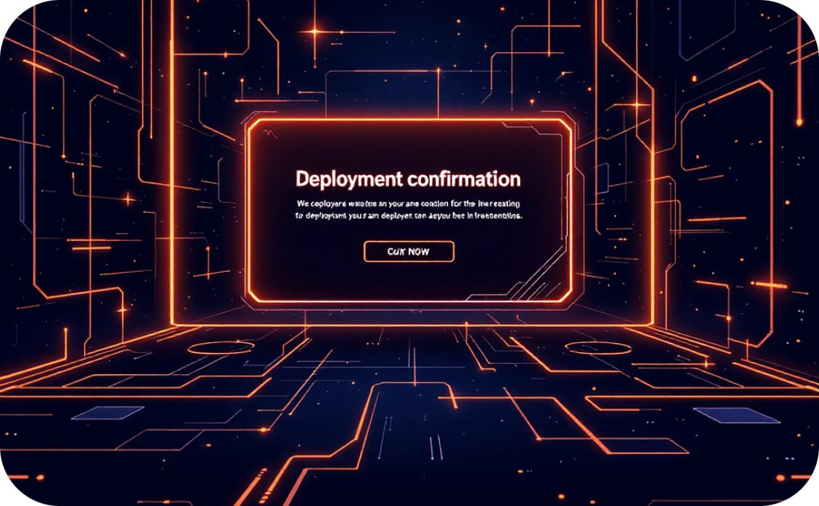
Key Deliverables
College Website
Apply Now Integration
Live Deployment
Home, About, Courses, Hostels, Gallery, Apply Now — responsive and accessible.
Form submissions sent to college email via Express.js + Nodemailer with validation.
Frontend hosted on Vercel; backend hosted on Render; live demo to Director completed.

Slide 10






Reflection & Acknowledgements
Project completed successfully with certificate awarded. Gratitude to faculty guide Mr. S. Ashok, Dr. P. Arunakumari, Principal Dr. R. Rajeshwara Rao, CSE staff, parents and Vinutna Junior College management.
Outcomes
Certification
Improved college visibility, streamlined admissions, and empowered staff with basic website maintenance skills.
Certificate of completion received on final day of deployment and training.

